Slide 1
IPL ANALYSIS
Data Analysis · Visualization · Predictive Analysis
- A Shree Harini

Slide 2
PROJECT SCOPE AND OBJECTIVES
Data Ingestion: Load IPL matches & deliveries datasets from Kaggle into MySQL database using SQLAlchemy.
Data Cleaning: Handle nulls (winner, city, player_of_match), remove duplicates, and parse date columns.
Visualization: Generate insights using Matplotlib/Seaborn static charts and an interactive Plotly Dash dashboard.
Predictive Analysis: Predict IPL match winners using Random Forest Classifier with Label Encoding on categorical features.

Slide 3
TECHNOLOGY STACK
TECHNOLOGY | TOOLS/LIBRARIES
Database | MySQL 8 · SQLAlchemy
Data Layer | Pandas, Numpy
Visualize | Matplotlib, Seaborn, Plotly
Dashboard | Plotly Dash (2x2 grid layout)
Prediction | Scikit-learn, RandomForest, LabelEncoder

Slide 4
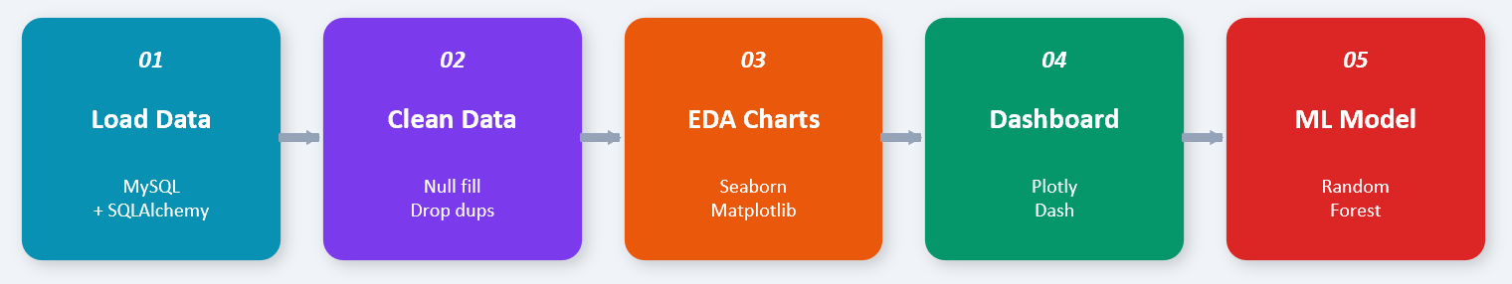
MODULES AND WORKFLOW
Module 1 – Data Ingestion: Read CSV via Pandas, push to MySQL using SQLAlchemy engine, verify with .shape.
Module 2 – Cleaning: fillna() for winner/city/player columns, drop_duplicates(), parse dates with pd.to_datetime().
Module 3 – EDA: 6 Seaborn/Matplotlib charts — season trends, team wins, toss analysis, top players, batsmen, bowlers
Module 4 – Plotly Dashboard: 2×2 subplot grid with Bar, Area, Donut, and Column charts (interactive HTML).
Module 5 – ML Model: LabelEncoder → 80/20 split → RandomForestClassifier(n_estimators=100) → predict match winner.

Slide 5
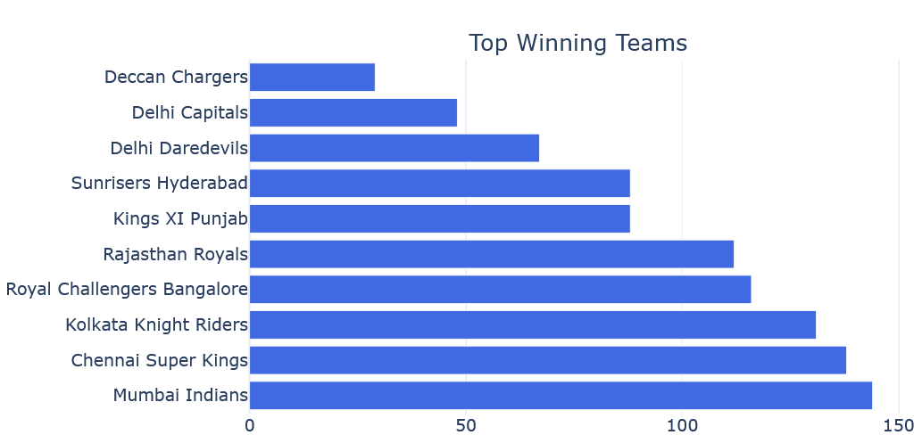
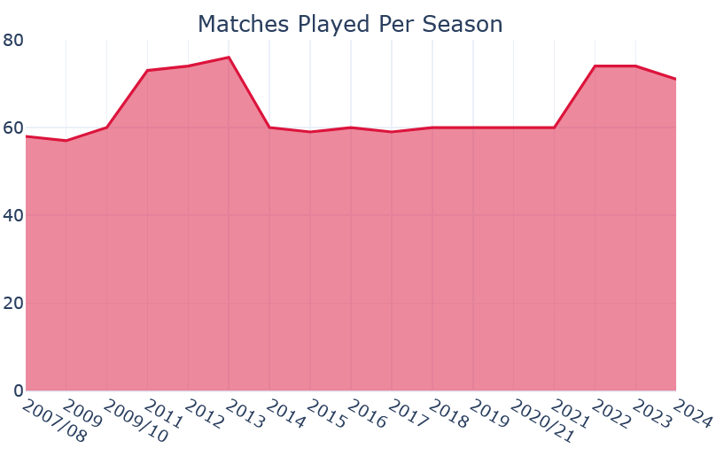
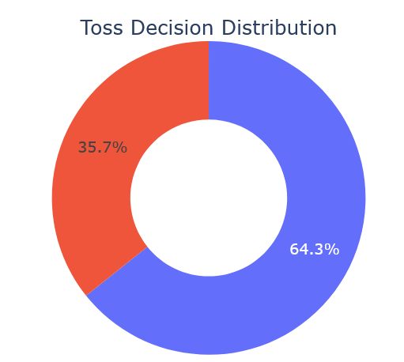
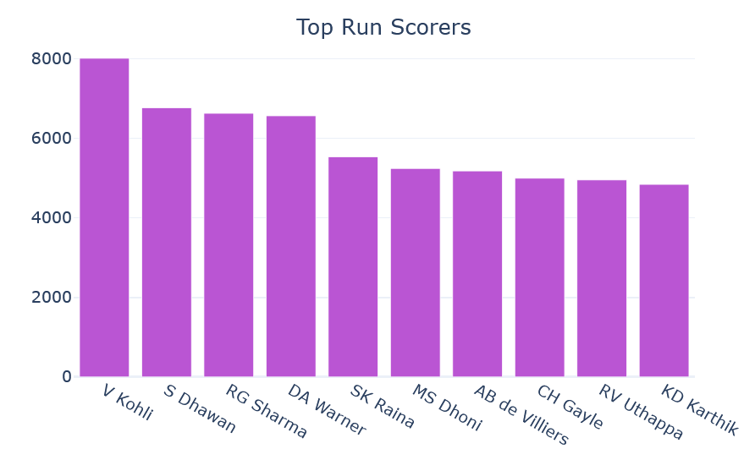
CHART INSIGHTS

Slide 6
PREDICTIVE ANALYSIS
Match Winner Prediction
To provide predictive insights, a Random Forest Classifier was developed using historical IPL match data.
Features Used
Team 1, Team 2, Toss Winner, Venue
Target Variable
Match Winner
Data
Selection
Data
Preprocessing
Label
Encoding
Train-Test Split (80:20)
Random Forest Classifier
Winner Prediction

Slide 7
THANK YOU

